Slide 1
Efficient Large Language Model Customization

Slide 2
Agenda
Introduction
LLM Customization Fundamentals
Parameter-Efficient Fine-Tuning Essentials
The Virtuous Cycle of Model Customization
Interactive Materials

Slide 3
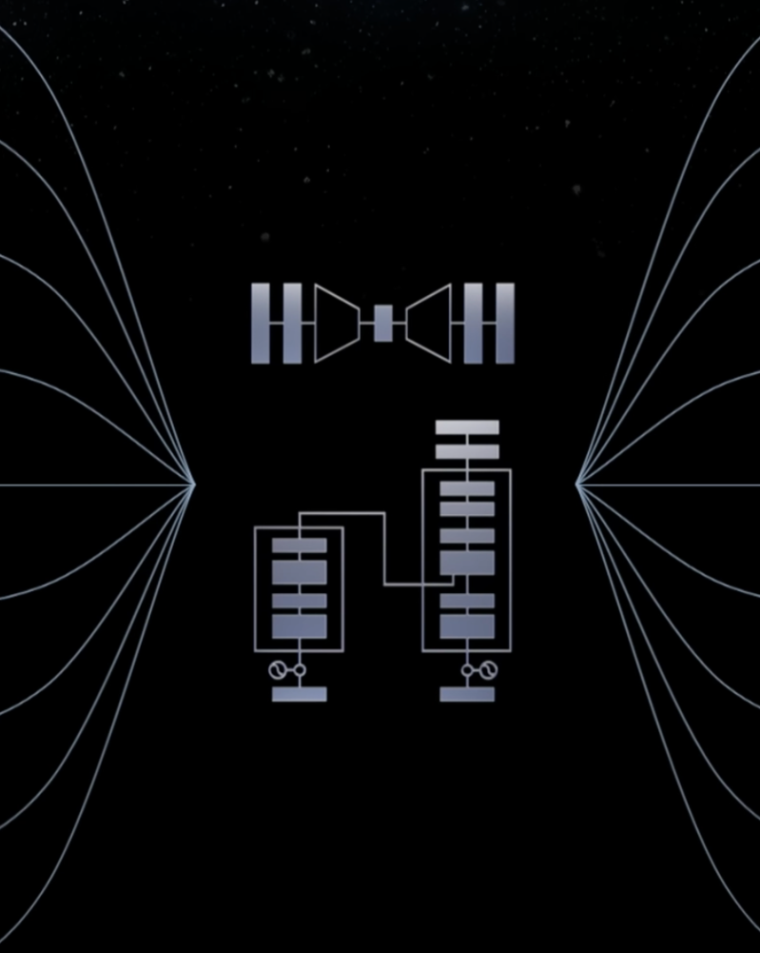
Workshop Objectives
By the end of this workshop you will:
Know How to Customize Models Efficiently
P-tuning
LoRA
Synthetic Data Generation (SDG)
Know When and Why to Customize Models
Increase Model Capabilities
Decrease Model Size
Decrease Prompt Context (number of tokens)
Enable Further Customization

Slide 4

Workshop Prerequisites
Fundamentals of Deep Learning
Deep learning 101 in Python
Participants should have a firm grasp of the neural network training process.
Rapid Application Development Using LLMs
LLM fundamentals
Participants should be familiar with transformer architecture and the process of converting text into tokens and embeddings.
Prompt Engineering with LLaMA-2
Prompt engineering best practices
Participants should be comfortable with iterative prompt engineering, including the use of model generation parameters.
Intermediate Python Experience
Python makes PEFT happy
Participants should feel comfortable writing and reading Python code that uses loops, classes, and higher-order functions.

Slide 5


Core Tools

Slide 6
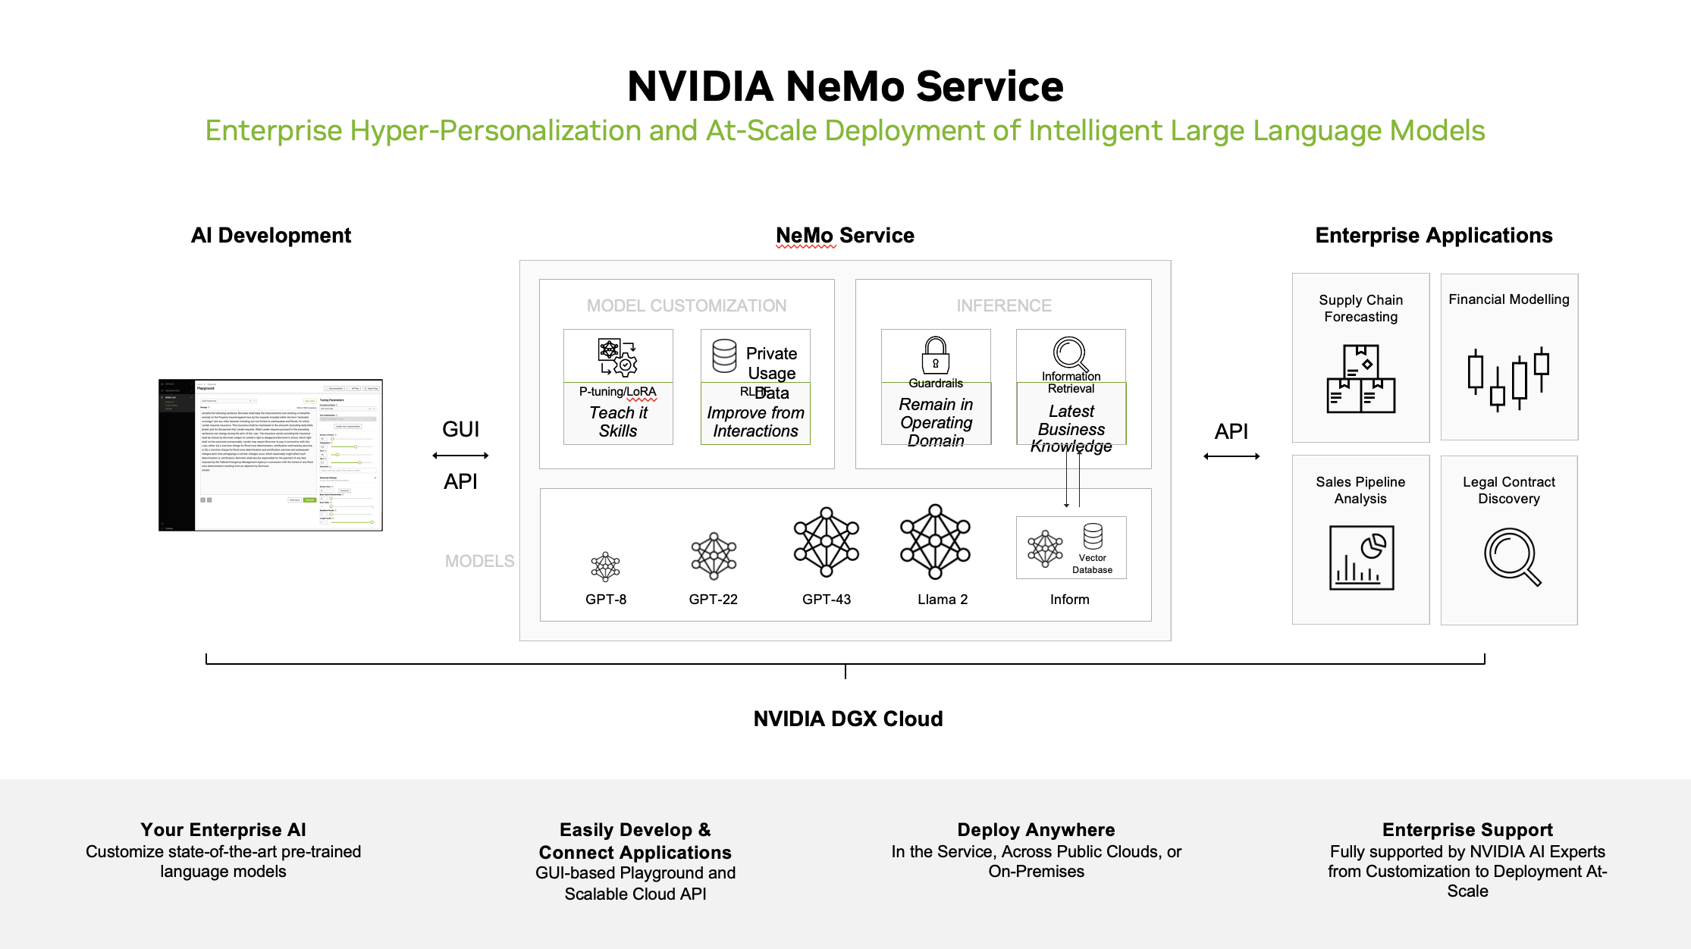

Slide 7
Agenda
Introduction
LLM Customization Fundamentals
Parameter-Efficient Fine-Tuning Essentials
The Virtuous Cycle of Model Customization
Interactive Materials

Slide 8
How We Define Efficient Model Customization
What is and isn’t covered in this workshop
Prompting with no intention
Intentionally modifying generation parameters (tokens_to_generate, temperature, top_k, etc.)
Intentional, iterative prompt engineering
Few-shot prompt engineering
Parameter-efficient fine-tuning methods (LoRA, P-tuning, et al.)
Supervised fine-tuning (or any method that unfreezes the base model’s weights)
LLM pretraining

Slide 9
The Progression of Model Customization
Understand your task requirements, constraints, and ideals
Task requirements: can be defined by prompt templates
Summarization: f'Summarize {input_text} in 20 words.’
Question Answering: f’Context: {context} Question: {question} Answer:’

Slide 10
The Progression of Model Customization
Understand your task requirements, constraints, and ideals
Task requirements: can be defined by prompt templates
Summarization: f'Summarize {input_text} in 20 words.’
Question Answering: f’Context: {context} Question: {question} Answer:’
Constraints come in many forms
Task performance thresholds: “My sentiment analysis task needs to be correct 95% of the time.”
Available models: “I need all my models to fit on a single A100.”
Prompt length: “This service is used extensively, and we need to reduce number of tokens sent to our LLM service.”

Slide 11
The Progression of Model Customization
Understand your task requirements, constraints, and ideals
Task requirements: can be defined by prompt templates
Summarization: f'Summarize {input_text} in 20 words.’
Question Answering: f’Context: {context} Question: {question} Answer:’
Constraints come in many forms
Task performance thresholds: “My sentiment analysis task needs to be correct 95% of the time.”
Available models: “I need all my models to fit on a single A100.”
Prompt length: “This service is used extensively, and we need to reduce number of tokens sent to our LLM service.”
Ideals above and beyond requirements
Additional task performance or capabilities: “We can make it with 85% accuracy, but 99% would save us a lot of headaches.”
Desire for smaller model: “The performance of this 70B model is great, but hosting it is costly.”
Desire for model reuse: “We already have 20B models deployed, it would be nice not to have to deploy another model.”
Desire for reduced prompt length: “We could really reduce inference latency if this prompt wasn’t so long.”

Slide 12
The Progression of Model Customization
Prompt Engineering
Iteratively develop a working prompt: ‘What is the capital of California?’
Test on additional inputs, continue iterating on prompt: f‘What is the capital of {state}?’
Add examples if needed (few-shot learning):
f‘Q: What is the capital of California? A: Sacramento Q: What is the capital of {state}? A:’
Create prompt templates out of working prompts:
def capital_prompt(state):
return f‘’’Q: What is the capital of California?
A: Sacramento
Q: What is the capital of {state}?
A:’’’

Slide 13
Agenda
Introduction
LLM Customization Fundamentals
Parameter-Efficient Fine-Tuning Essentials
The Virtuous Cycle of Model Customization
Interactive Materials

Slide 14
The Progression of Model Customization
PEFT when your task requirements, constraints, and ideals require more than prompt engineering
PEFT for better task performance with the same model
PEFT for the same (or at least acceptable) performance with smaller models
PEFT for the same, or better (or at least acceptable) performance with shorter prompts

Slide 15
The Progression of Model Customization
PEFT process at a high level
Create task template, often through prompt engineering
def capital_prompt(state):
return f‘’’Q: What is the capital of California?
A: Sacramento
Q: What is the capital of {state}?
A:’’’
Acquire sufficient training data for use with your task template (hundreds to thousands of samples).
Hand-curated from your organization: work intensive but this can be excellent data and you can automate
Existing datasets: if it’s well-suited to your task and licensing works for you, this can be a boon
Synthetic: Use LLMs to generate data for fine-tuning.
Be responsible about licensing, some very powerful LLMs state explicitly you cannot use their outputs to improve other potentially competitive models.
Use task template and data to do parameter-efficient fine-tuning
Test and iterate

Slide 16
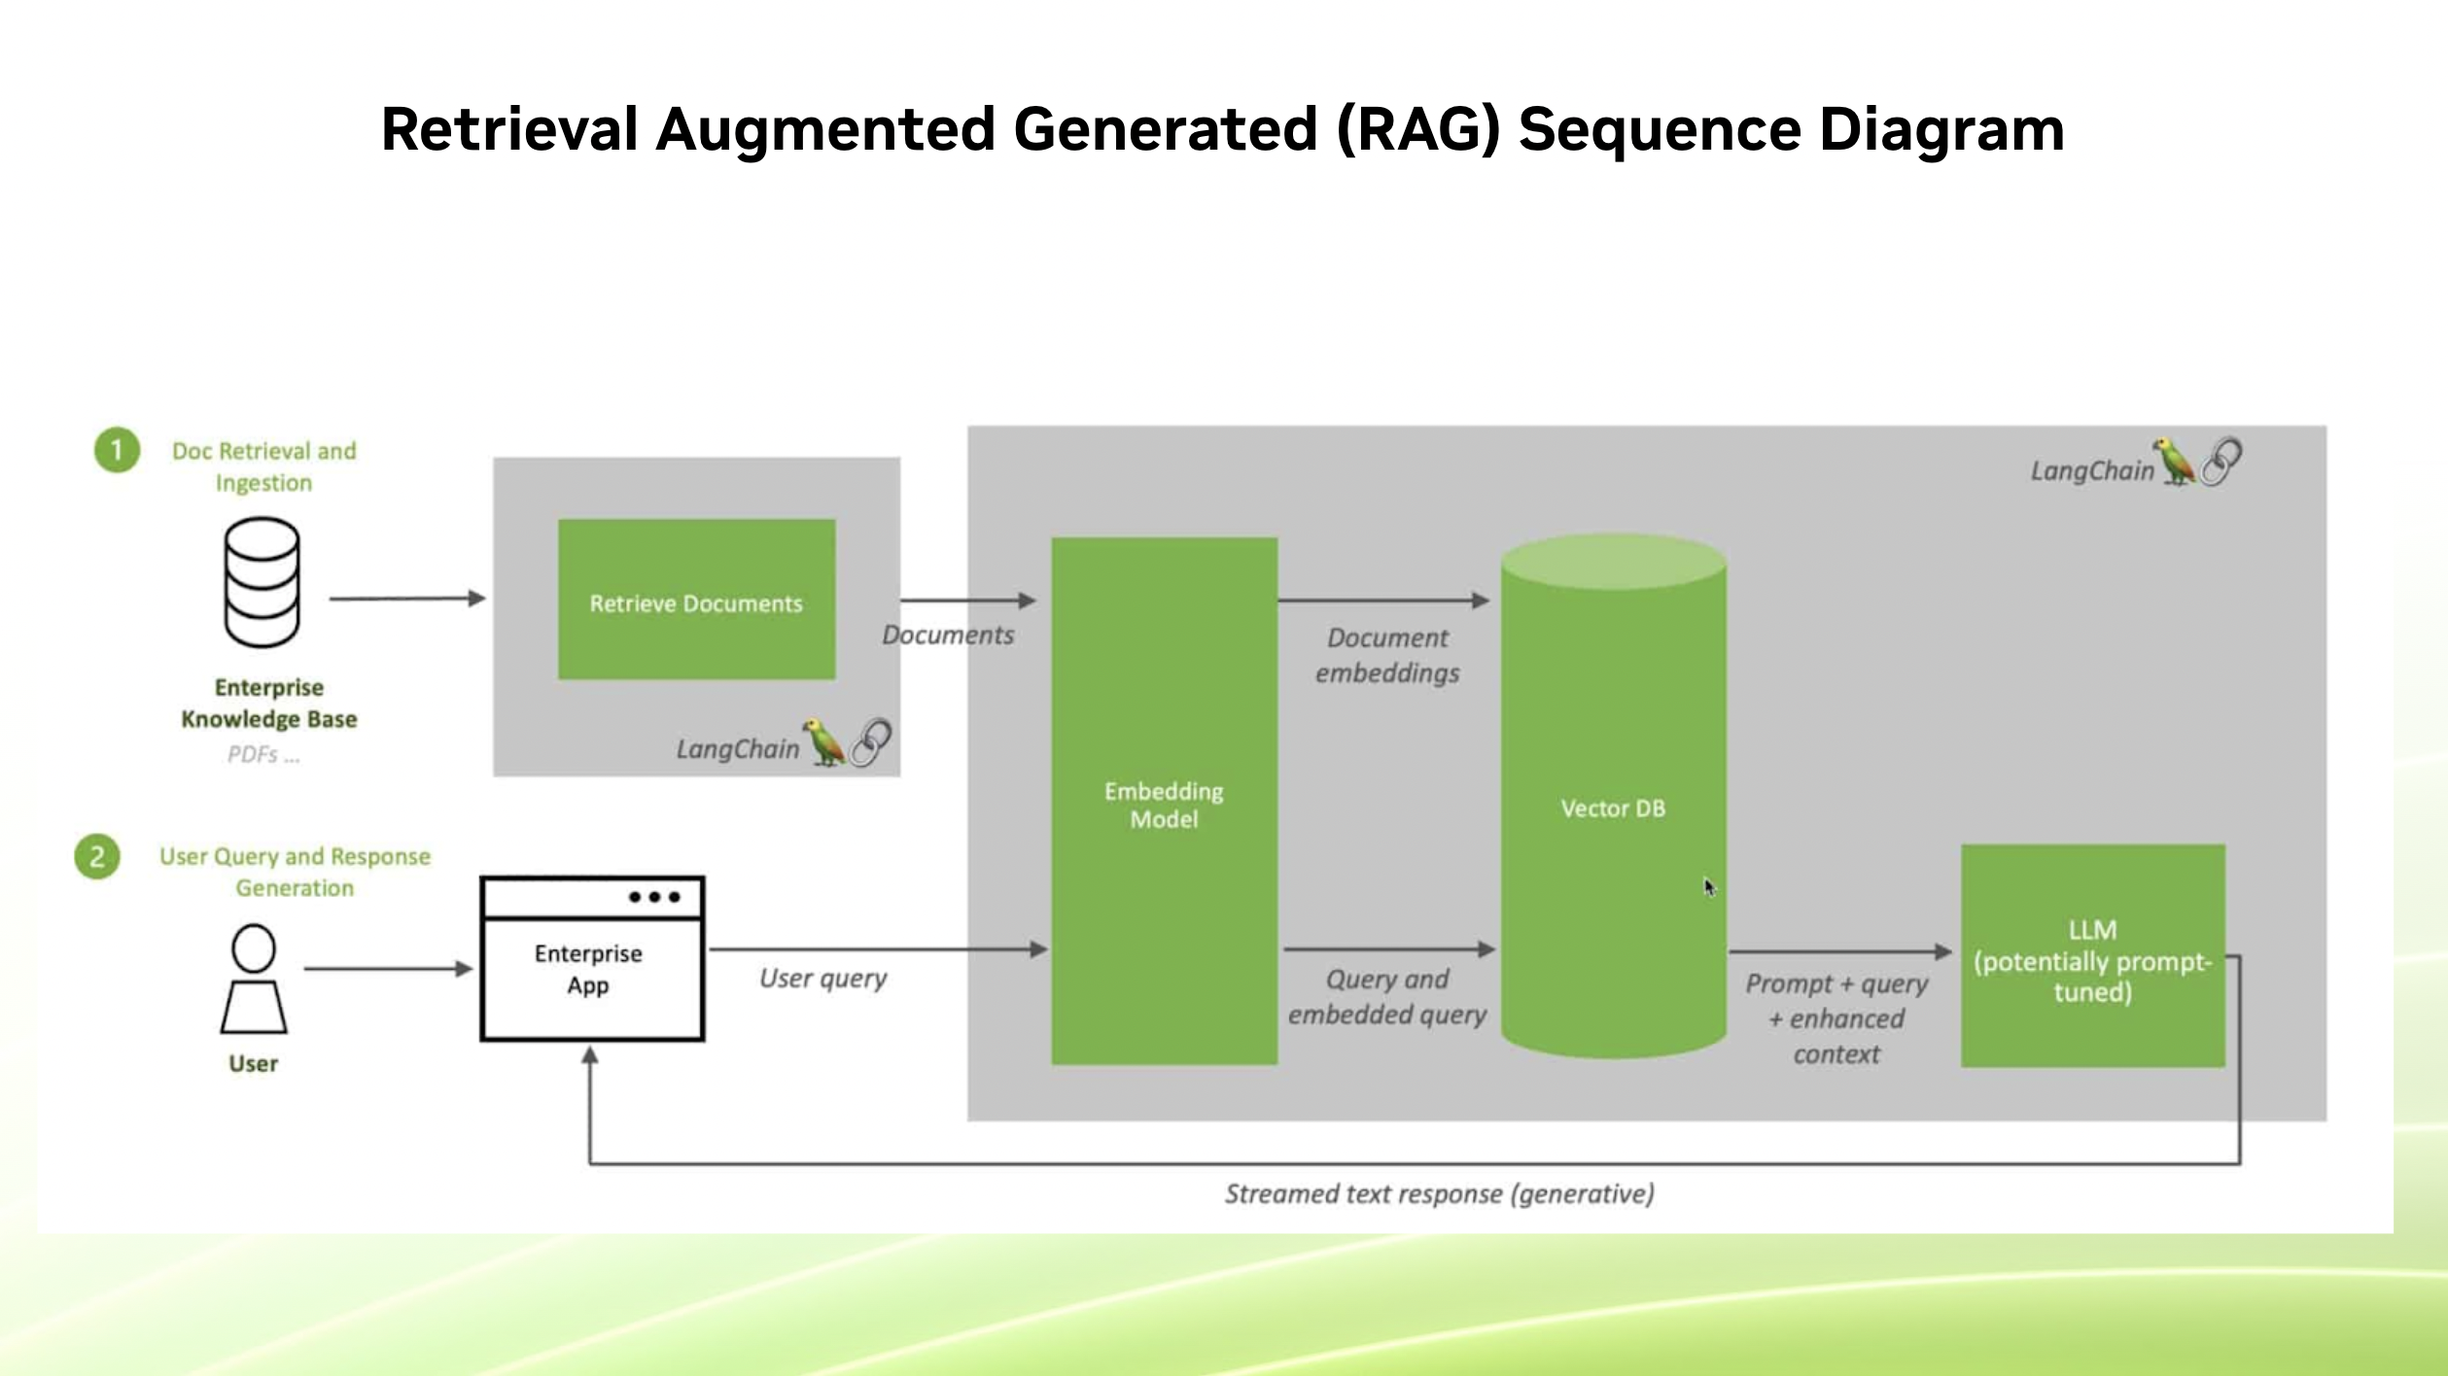
The Progression of Model Customization
Model customization and RAG

Slide 17
Agenda
Introduction
LLM Customization Fundamentals
Parameter-Efficient Fine-Tuning Essentials
The Virtuous Cycle of Model Customization
Interactive Materials

Slide 18
The Virtuous Cycle of Model Customization
PEFT and SDG together can do a lot to reduce model size
With some hand-written seed prompts, generate synthetic prompts
Use synthetic prompts with a large LLM for high-quality responses
Use prompts and responses to create training data
Fine-tune a smaller model with synthetic prompts, and responses from larger LLM
Compose fine-tuned models to generate data for additional tasks

Slide 19
Agenda
Introduction
LLM Customization Fundamentals
Parameter-Efficient Fine-Tuning Essentials
The Virtuous Cycle of Model Customization
Interactive Materials

